Slide 1
Current State: FINAL
Role | Name | Reviewed / Approved
Deck Owner | Nikola Metulev
Tech/Msg Review | Jeremy Thake
Tech/Msg Review

Slide 2
Helpful speaker prep content
Microsoft Graph: Powering your applications with Microsoft 365 services: https://mybuild.techcommunity.microsoft.com/sessions/77020
Simplifying your app’s user sign-in and authentication using the Microsoft identity platform
https://mybuild.techcommunity.microsoft.com/sessions/77028
Building a Microsoft Graph-powered productivity app
https://mybuild.techcommunity.microsoft.com/sessions/77025

Slide 3
Key messages / take-aways for this deck
Get started today by using the Microsoft Graph to build your tailored experiences or customizations

Slide 4
Important Presentation Notes
If there are any other Graph sessions being presented after this session (such as Microsoft Graph in Desktop apps), call them out towards the end

Slide 5
System Requirements
Windows 10 latest
Microsoft Edge Next
VS Code
NodeJS
Git

Slide 6
Speaker Technical Skills
Demos are all scripted, but the anticipated set of required skills includes
VS Code, NodeJS, NPM,
The Graph Explorer web site
Calling REST APIs (may also include desktop and PWA apps for the clients. )
Basic HTML/JS knowledge

Slide 7
Demo Notes: Demo Name
<Script for the demo. Use more than one slide if you need to>

Slide 8
Microsoft Graph
Riccardo Cappello
ICS Senior Consultant @ Insight – Microsoft Azure MVP

Slide 9
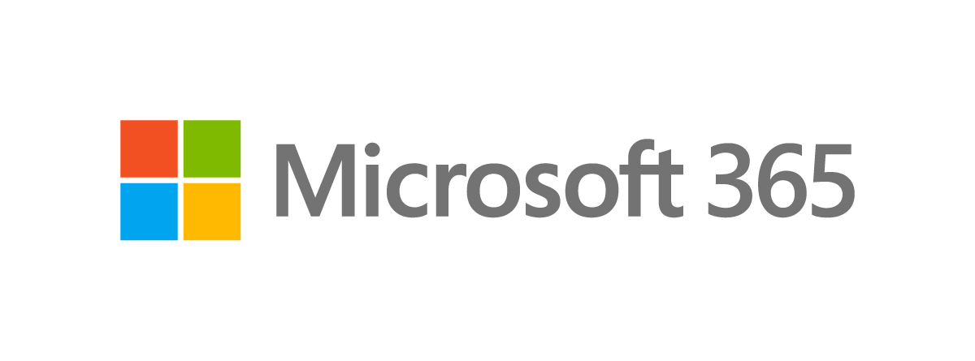
Office 365
Your tailored experiences or customizations
Windows 10
Enterprise Mobility + Security
Notes:
At Microsoft we create people centric experiences that empower everyone to be creative and work together, securely. We do this in a very generic way by producing mass market applications, like the ones in Office 365, Windows and the Enterprise Mobility and security suite. These are products serve the needs of customers across industry verticals and customer segments. For example we offer the same Office experience for users, whether they are in legal, retail or education, in a small or medium business or in a large fortune 500 organizations.
But there exists more specific needs, for industry verticals or just your own company…. And we rely on our partners, and developers like you, to build these tailored experiences that maximize productivity of our users. [CLICK]
In this talk we are going to share how you can use the Microsoft 365 platform, and more specifically the Microsoft Graph, to build tailored experiences and customizations to maximize the productivity of our shared customers.

Slide 10
1 billion
1 million
100 billion
users across work, life and edu
monthly active apps using Microsoft Identity
Microsoft Graph requests per month
Your tailored experiences or customizations
18 trillion
90%
180 million
Microsoft Graph nodes
Fortune 500
monthly active users of Office 365 commercial
Notes:
For developers there exists an enormous opportunity to partner with Microsoft and have those tailored experiences reach a large audiences across consumer and commercial and build on the same platform that we use to build our own experiences.

Slide 11
Microsoft Graph Gateway to your data in the Microsoft cloud
https://graph.microsoft.com
Office 365
Windows 10
Enterprise Mobility + Security
Users, Groups, Organizations
Outlook
SharePoint
OneDrive
Teams
Planner
Excel
OneNote
Activities
Device Relay
Commands
Notifications
Azure AD
Intune
Identity Manager
Advanced Threat Analytics
Advanced Threat Protection
Dynamics 365
Business Central
Mail, Calendar,
Contacts and Tasks
Sites and Lists
Drives and Files
Channels, Messages
Tasks and Plans
Spreadsheets
Notes, and more…
Identity Management
Access Control
Synchronization
Domains
Administrative Units
Applications and Devices
Advanced Threat Analytics
Advanced Threat Protection
Alerts
Policies
and more…
Notes:
One more way of looking at what Microsoft Graph has to offer is by looking at the resources it exposes
These services and the suite of products behind them, have core entities that drive user productivity and the one of the first steps on my journey to serve you as a developer is to expose these core entities in a coherent and consistent form so that you can interact with them and use them in your tailored solutions.

Slide 12

Microsoft 365 Platform
Extend Microsoft 365 experiences
Build your experience
Documents
Conversations
Portals
Timeline
Search
Web apps
Bots & agents
Device & native
Daemon apps
Workflow automation
Analytics apps
Microsoft Graph
REST APIs and webhooks
Microsoft Graph
Your local data
Azure AI platform
Office 365
Windows 10
Enterprise Mobility + Security
Microsoft Graph
data connect
Connectors
Microsoft Identity
Notes:
[This slide has animations and builds up]
We are offering developers a platform to build people-centric productivity experiences that increase the effectiveness and engagement of their apps.
The foundation of this platform is the Microsoft identity. This is where the we have the identity, across work and life, of each user and organization. And for developers it offers standards-based auth libraries, seamless sign-in/up/SSO and app model that enable access to the data in Microsoft 365.
[CLICK]
Then we have the Microsoft Graph, the gateway to your customers data in the Microsoft cloud, primarily in Microsoft 365. The Microsoft Graph provides the core schema for many of the most important productivity data types
There are three interfaces for developers
[CLICK]
1st, there is the REST API to build [CLICK] experiences that are standalone or as [CLICK] extensions to experiences we have on m365 today
[CLICK]
2nd interface is data connect that allows you to move data from the m365 services and move it to Azure Data Lake without any code. It handles lifecycle and security so you don’t have to do it yourself. [CLICK] it enables experience such as analytics apps
[CLICK]
And Finally, the 3rd interface is the ability to ingest your own data to the Microsoft Graph.
The Microsoft Graph offers: 1. REST API, 2. Data Connect, 3. Connectors

Slide 13
Demo
Getting started: Microsoft Graph Explorer

Slide 14
Demo Notes: Demo Name
Start by going to graph.microsoft.com and navigating to the Graph Explorer
Show getting JSON from the /me endpoint
Show the different samples and point out that each samples point to the docs
Show additional samples and enable few of your favorites (ex: calendar, one drive, etc).
Login with the tenant account and retrieve real data
Have outlook.com logged in in a separate window and snap it side by side with the Graph Explorer
Post a draft email in the Graph Explorer and show the draft showing in the outlook.com view
Finally, navigate to the documentation and make sure developers are aware of the different sections
Notes:
1. Add a draft
POST https://graph.microsoft.com/v1.0/me/messages
{
"subject": "message subject"
}
2. Patch a draft (copy id from previous call)
PATCH https://graph.microsoft.com/v1.0/me/messages/{id}
{
"subject": "message updated subject
}
2.5 (optional) show the Prefer header
header: Prefer = return=minimal
3. Delete draft
DELETE https://graph.microsoft.com/v1.0/me/messages/{id}

Slide 15
App patterns examples
Web apps,
device & native
Bots & agents
Background
process & automation
Analytic apps
Scheduling app for flight crew
Lost luggage helper
New flight crew provisioning
Flight crew analysis
Notes:
Why we are doing this? Let’s talk about just few patterns where you the Microsoft Graph is leveraged. There are many other patterns you might use as well.
We will use a fictional regional airline company, that has a handful of developers that are tasked to build several experiences to manage the day to day of this airline and it’s employees. Using this fictional company will help us frame several patterns that can illustrate just few examples that benefit by using the Microsoft Graph. Contoso airlines has over 5000 employees, and just a handful of developers, and as most businesses, they are a Office 365 subscriber.
1st, Contoso Airlines has built a web application used by flight crew and flight coordinators to manage schedules across hundreds of flight attendants, pilots and ground crew. They use the Microsoft Graph to coordinate schedules, vacations, communications and lot more
2nd, as with any airline company, Contoso airlines is looking for ways to provide great customer experiences, especially in situations such as a lost luggage. Because their whole team is leveraging Teams for their communication and day to day work, they’ve built a bot that helps in prioritizing these issues and automatically provisioning Teams channels and including the appropriate personal across the region
3rd, for every flight, Contoso Airlines uses Teams team for communication across the pilots, flight attendants and ground crew. With the number of flights happening constantly, they’ve set up background process to keep track of all flights, and automatically create teams, include the right personal, send status emails, and tear down the team once the flight is over
And finally, with thousands of flights and customers, Contoso Airlines strives to learn and improve. They use Microsoft Graph data connect to analyzes all of their data in the cloud and build custom analytics tools.

Slide 16
Microsoft Graph “a la carte” data and services
Apps
Web
Native
Bots
Flows
Automation
Analytics
Auth
Auth-code
Implicit-grant
Device-code
On-behalf-of
Client-credentials
UX
Web Components
React components
UWP Components
Pickers
Adaptive cards
Libraries
C#
JavaScript/Node
Java
ObjectiveC
PHP
Python
Capabilities
Webhooks
Deltas
Query
Notifications
Data Extensions
More...
Interfaces
Connectors
Microsoft Graph
REST APIs and Webhooks
Microsoft Graph
Data Connect
Data
Microsoft 365
Your domain
Notes:
Microsoft Graph offers a wide variety to data, components and services that help you build different types of apps. On top of the different ways you can leverage the Microsoft Graph, there are various tools and capabilities you will use depending on what kind of experiences you want to build.

Slide 17
Microsoft Graph-powered web apps - example
Apps
Web
Native
Bots
Flows
Automation
Analytics
Auth
Auth-code
Implicit-grant
Device-code
On-behalf-of
Client-credentials
UX
Web Components
React components
UWP Components
Pickers
Adaptive cards
Libraries
C#
JavaScript/Node
Java
ObjectiveC
PHP
Python
Capabilities
Webhooks
Deltas
Query
Notifications
Data Extensions
More...
Interfaces
Connectors
Microsoft Graph
REST APIs and Webhooks
Microsoft Graph
Data Connect
Data
Microsoft 365
Your domain

Slide 18
Microsoft Graph-powered automation apps - example
Apps
Web
Native
Bots
Flows
Automation
Analytics
Auth
Auth-code
Implicit-grant
Device-code
On-behalf-of
Client-credentials
UX
Web Components
React components
UWP Components
Pickers
Adaptive cards
Libraries
C#
JavaScript/Node
Java
ObjectiveC
PHP
Python
Capabilities
Webhooks
Deltas
Query
Notifications
Data Extensions
More...
Interfaces
Connectors
Microsoft Graph
REST APIs and Webhooks
Microsoft Graph
Data Connect
Data
Microsoft 365
Your domain

Slide 19
Demo
Getting started: docs

Slide 20
Demo Notes: Demo Name
navigate to the documentation and make sure developers are aware of the different sections
SDKs
Reference docs

Slide 21


Microsoft Identity
Anchor for cross-platform experiences
Over 1 billion users a month across work, school, and personal
Seamless authentication experiences for 1st and 3rd party
Enterprise grade security and management
Notes:
let’s touch a bit on what it takes to authenticate and access the Microsoft Graph. Identity is foundation
To call Microsoft Graph, your app must acquire an access token from the Microsoft identity platform. The access token contains information about your app and the permissions it has for the resources and APIs available through Microsoft Graph. To get an access token, your app must be registered with the Microsoft identity platform and be authorized by either a user or an administrator for access to the Microsoft Graph resources it needs.
Microsoft identity platform is an evolution of the Azure Active Directory (Azure AD) identity service and developer platform.

Slide 22
Introducing: Microsoft Authentication Libraries
Make it easy for your application to sign in users and get access tokens to securely call protected APIs

Slide 23
Demo
Getting started: app registration, quick-start

Slide 24
Demo Notes: Demo Name
Part 1. Quick Starts (3 minutes to working example)
Start from graph.microsoft.com and navigate to quick starts (Getting Started dropdown)
Select Node.js-> Get an app ID and secret (log in with tenant account)
Copy secret in clipboard
Download the zip-> unzip and open in VS Code -> run npm install
While npm install is going, open .env-> paste secret
npm start
Sign in with your tenant account
Show calendar view
Show graph.js

Slide 25
Demo Notes: Demo Name
Part 2: Azure Portal (optional – if time)
Tab to the Azure Portal and Azure Active Directory -> App registrations
Click on the created app from part 1
Show the Authentication section, specifically where the redirect URIs go
Show API permissions
Finally, show the Quickstarts

Slide 26
App patterns examples
Web apps,
device & native
Bots & agents
Background
process & automation
Analytic apps
Example
Scheduling app for flight crew
Lost luggage helper
New flight crew provisioning
Flight crew analysis
Auth
Interactive user
Device code
App only
App only
Ingredients
Microsoft Graph toolkit
Adaptive cards
Azure Functions bindings
Microsoft Graph data connect
Notes:
Why we are doing this? Let’s talk about just few patterns where you the Microsoft Graph is leveraged. There are many other patterns you might use as well.
We will use a fictional regional airline company, that has a handful of developers that are tasked to build several experiences to manage the day to day of this airline and it’s employees. Using this fictional company will help us frame several patterns that can illustrate just few examples that benefit by using the Microsoft Graph

Slide 27
App patterns examples
Web apps,
device & native
Bots & agents
Background
process & automation
Analytic apps
Scheduling app for flight crew
Lost luggage helper
New flight crew provisioning
Flight crew analysis
Interactive user
Device code
App only
App only
Microsoft Graph toolkit
Adaptive cards
Azure Functions bindings
Microsoft Graph data connect
Notes:
Why we are doing this? Let’s talk about just few patterns where you the Microsoft Graph is leveraged. There are many other patterns you might use as well.
We will use a fictional regional airline company, that has a handful of developers that are tasked to build several experiences to manage the day to day of this airline and it’s employees. Using this fictional company will help us frame several patterns that can illustrate just few examples that benefit by using the Microsoft Graph

Slide 28
Microsoft Graph today | Data sets
Generally Available ( /v1.0 ) | Preview ( /beta )
Office 365 Exchange (get schedule) SharePoint (get item analytics) Teams APIs EMS Security (secure score) AAD (audit and sign in logs, identity providers, groups naming policy, group based licensing APIs, nested membership expansion on groups, export personal data) Microsoft Graph data connect | Office 365 Exchange (MIME messages, MIME item attachments, raw file attachments) SharePoint (security events webhooks) OneDrive (follow/unfollow documents, expiring links in permissions API) Teams (1:1 chat messages, shifts management) Connectors private preview EMS Security (Logic App/Flow/Power Apps connectors, Power BI connector, Jupyter Notebooks, threat indicators, security actions) AAD (application sign-in reports, custom sign-up and sign-in policies in Azure AD B2C, risky user and history) Dynamics Business Central (Financials)
Notes:
Now generally available
Microsoft Graph data connect
Calendar: Get free-busy schedule
Identity and access:
Audit and sign-in logs
Identity providers
Migrate apps from AAD Graph to Microsoft Graph
Lists: Get item analytics
Security: Secure score
New in beta
Financials: Dynamics 365 Business Central
Groups:
Group expiration date
Validate group naming
Identity and access:
Access reviews support application permissions
Application sign-in reports
Custom policies in Azure AD B2C
Risky user and history
Mail, calendar, contacts:
Get MIME content of messages
Get raw/MIME content of attachments
Reduce missing change notifications
Security: Threat indicators, security actions
Teamwork: Shifts management, 1:1 chats

Slide 29
Microsoft Graph today | DevX Tooling
Generally Available | Preview
SDK Releases .NET – Version 1.15 Java – Version 1.3 Android Support Java – Version 1.X lightweight core library (*new*) JavaScript – Version 1.6.0 Objective C – Version 1.0 (*new*) New SDK Features (across languages) Retry and Redirect Support Download decompression support Page iterator Task Large File Upload Task Client Factory Docs SDK Getting started docs Code snippets in reference documentation (.NET, Java) | Updated SDKs for Beta API .NET PHP Typescript New SDK Features (across languages) Microsoft Graph Authentication Providers for MSAL Microsoft Graph Toolkit Postman collections Docs Embedded try experience (coming soon)
SDKs and Toolkit are all OSS on https://github.com/microsoftgraph
Notes:
Expect regular updates to the beta

Slide 30
Demo
Getting started: Microsoft Graph Toolkit

Slide 31
Demo Notes: Demo Name
Prerequisites: VS Code with the Live Server Extension (configure live server extension to use localhost)
Start with the repo page of the Microsoft Graph Toolkit
In a index.html file, reference the Microsoft Graph Toolkit in the head
Add a <mgt-login> component -> Start live server and open in Edge Next
Go to azure portal (from last demo, and copy the client ID). Also make sure to add the localhost:8080 to the redirect urls
Back to the code, add <msal-provider> with the client ID you copied -> show the code now working in the browser
Back to the code, add the <mgt-agenda> component and show it working.
Back to the code, add a quick template to overwrite the event template and show templating

Slide 32
Microsoft 365 Platform
Extend Microsoft 365 experiences
Build your experience
Documents
Conversations
Portals
Timeline
Search
Web apps
Bots & agents
Device & native
Daemon apps
Workflow automation
Analytics apps
Microsoft Graph
REST APIs and webhooks
Microsoft Graph
Your local data
Azure AI platform
Office 365
Windows 10
Enterprise Mobility + Security
Microsoft Graph
data connect
Connectors
Microsoft Identity

Slide 33
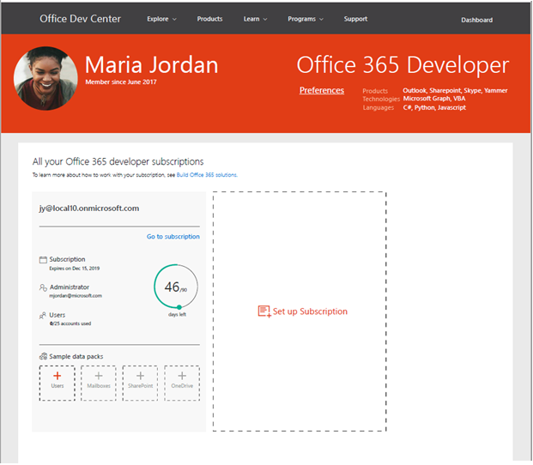
Join the Developer Program
https://aka.ms/o365devprogram
Benefits
Free renewable Office 365 E3 subscription Be your own admin
Dev sandbox creation tools
Preload sample users and data for Microsoft Graph, and more
Access to Microsoft 365 experts
Join bootcamps and monthly community calls
Tools, training and documentation
Learn, discover and explore about Office 365 development
Blogs, newsletters and social
Stay up to date with the community

Slide 34

Get started today
Office 365
Your tailored experiences or customizations
Windows 10
Enterprise Mobility + Security
aka.ms/insiderdevtour-labs
Notes:
One thing to remember from today is aka.ms/idt2019resources for everything we talked about in all the sessions

Slide 35
aka.ms/insiderdevtour-labs
Notes:
Thanks!

